Slide 1
State of the college
August 4, 2023

Slide 2
WELCOME!
Notes:
Sonia Miranda- Congressman Obernolte’s Office
Mrs Van Norman- Excelsior Principal, Barstow Site
Camren Jones- Area Director Excelsior
Miriam Munoz- City of Barstow, PIO
Willie Hopkins- City of Barstow, City Manager
Kody Tompkins- City of Barstow, Asst. City Manager
Laura Moraco- Barstow Veterans Home, PIO
Albert Gallegos- BCF Board President
Juan Rivera- BCF Vice President
Louise Miller (virtual)- BCF Board Member
Edy Seehafer (virtual)- BCF Treasurer
Introduce Trustees – Board President Wilkey unable to attend today although he sends his regards and appreciation for all those here.
Thank all of our Trustees, Fernando Baca, Yolanda Minor, and John Gregg.
Julie Hackbarth-McIntyre
Julie was born and raised in Barstow. She is a proud graduate from Barstow High School. She attended Barstow Community College as a student the first year after high school and later transferred to CSU Long Beach. Upon returning to her home town after college, she became involved in the community
Coached swimming for 8 years
Became involved with the Chamber of Commerce and served on the Chamber’s Board of Directors
Founding board member of the Boy’s and Girl’s Club of Barstow,
Served as a member of the Soroptimist Club of Barstow for many years,
1999 elected to the Barstow Fire Protection District Board
2006 elected to Barstow City Council
2012 elected Mayor for City of Barstow
She is also an honorary member of the Officers Wives Club at Fort Irwin.
1993-2022 – Served on the Board of Directors for the Barstow College Foundation (29 years)
Many of you know that Julie’s family is the Founders of Del Taco, with the original and famous Del Taco right in town on 1st street.
Julie’s accolades and awards are numerous,
Previously, Mayor Hackbarth-McIntyre was honored by the Chamber of Commerce as the Barstow “Woman of the Year” and as “The Woman of Continuous Service.
She was a recipient of the “Women of Distinction Award” by Rep. Paul Cook.
In 2015 she was named the Senate District 16's San Bernardino County Woman of the Year
Most recently, and further demonstration of her lifelong commitment to Barstow, Julie was elected in 2022 to the Barstow Community College District Board of Trustees and is currently the Vice President.

Slide 3
UNSTOPPABLE
Notes:
This year in sharing with you my “state of the college” address, what underpins my entire message is the confidence I have in our college, our people – faculty and staff, our supportive Board of Trustees, and our community partnerships – confidence that our college is Unstoppable.
I don’t say this based on sheer hope or in an effort to inspire all of us to pull together to achieve great things for our students and community – I say it because after six years of serving as your superintendent-president I have demonstrable evidence that this institution is most certainly the “best rural college in California”

Slide 4
Strategic momentum
Notes:
First I’ll highlight and remind everyone of the important institutional work that we began last year and that we continue into the coming year that will have important implications for our college moving into the near and longer-term future.

Slide 5
Momentum from last year
Accreditation
Self-Evaluation report due to ACCJC August 2024
Peer Team Review fall 2024
Site visit spring 2025
Educational and Facilities Master Planning with Gensler
Launched fall 2023
Planning Taskforce
Mission/Vision/Values integration
Notes:
Thank our Accreditation Tri-Chairs for leading the work of conducting our self-evaluation and coordinating the development of the report – Lisa Holmes, our Accreditation Liaison Officer and Director of Research & Planning, Academic Senate President, Dr. Rudy Duque and now Melissa Matteson, past and current Academic Senate Presidents, and Courtney Quenga, our Classified Chair of the Accreditation Steering Committee.

Slide 6
Expansion of Dual Enrollment
High School | Headcount | Enrollment | Average Sections per Student
ACE | 19 | 49 | 2.6
Baker Valley Union | 6 | 14 | 2.3
Barstow High School | 17 | 71 | 4.2
Central High School | 6 | 7 | 1.2
Hesperia Christian | 53 | 139 | 2.6
Mojave River | 5 | 10 | 2.0
Redlands Christian | 3 | 3 | 1.0
Riverside Prep | 134 | 377 | 2.8
Silver Valley High | 25 | 81 | 3.2
Springs Charter | 57 | 96 | 1.7
Total Transitional High School Admits | 325 | 847 | 2.6
Total Non-Transitional High School Admits (includes Excelsior) | 217 | 534 | 2.5
Notes:
Programmatic momentum
Based on requests from our high school partners, both local and those who heard about some of our online dual enrollment offerings, we have begun to significantly expand our dual enrollment.
We have done this not only because it has helped the institution grow enrollment, but most importantly because it provides our local high school students the opportunity to access college education early on, earn college credit to accelerate their path toward earning their associates and later their bachelor’s degree.
Many of you know that growth in Dual Enrollment is also one of the outcomes communicated by the California Community College system’s new Chancellor, Dr. Sonya Christian, in her preliminary 2030 Vision Framework . It aligns with her goal around equity in access.
Working together with our K12 partners, we plan to continue to expand our dual enrollment offerings. And with all of our initiatives, as we launch and grow them, we engage in a cycle of implementation, evaluation of how we did, and refinement based on that evaluation to make sure we are providing equitable access and supports across all student groups and that students are succeeding equitably in those courses as well..

Slide 7
Expansion of noncredit offerings
ESL
Citizenship Preparation
Basic Skills
CTE
Short-Term CTE Certifications
Serving Probation Students

Slide 8
Expansion of noncredit offerings
Customer Service
Cal OSHA Forklift Training
Trade Technician

Slide 9
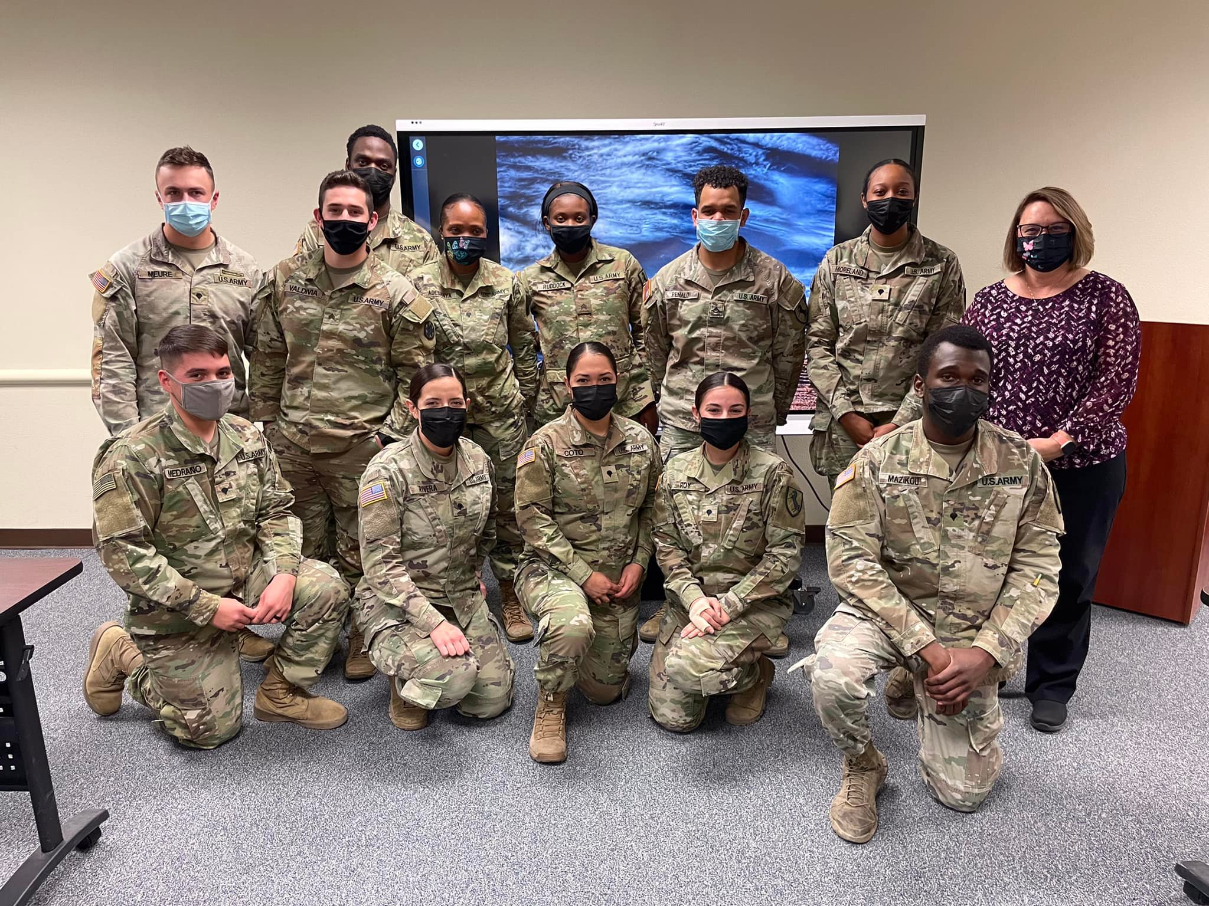
Expansion of noncredit offerings
SDEV 160
Student Development Program

Slide 10
Expansion of noncredit offerings
KINA 150 Fitness & Wellness Lab

Slide 11
BCC Athletics program compliance review
“The visit was well organized, and the student athletes and staff interviewed were all well informed and engaging. It was apparent throughout the visit and within the report that Barstow College Athletics Department is an integral part of the campus and a highly valued member of the Inland Empire Athletic Conference.”
Tony Lipold
Commissioner
Inland Empire Athletic Conference

Slide 12
Building on Affirmed successes

Slide 13
Campaign for college opportunity award

Slide 14
Leading higher education in supporting the whole student

Slide 15
Leading Support of basic needs through community partnerships
Notes:
In a zoom meeting earlier this week, where we were invited by the Legislative Analyst’s Office in Sacramento to share what we have done with state funding to implement our Homeless and Housing Insecurity Program. Director Shannon Batchez, Director Samera Kabir, Heather, joined by community partners from New Hope Village and Desert Sanctuary to enlighten the researchers hired by the LAO to better understand the challenges on the ground in Barstow to address the needs of our housing and food insecure students.

Slide 16
Leader in high quality de instruction and academic supports
Peer Online Course Review (POCR)
California Reading and Learning Association Certified

Slide 17
Challenges & opportunities ahead

Slide 18
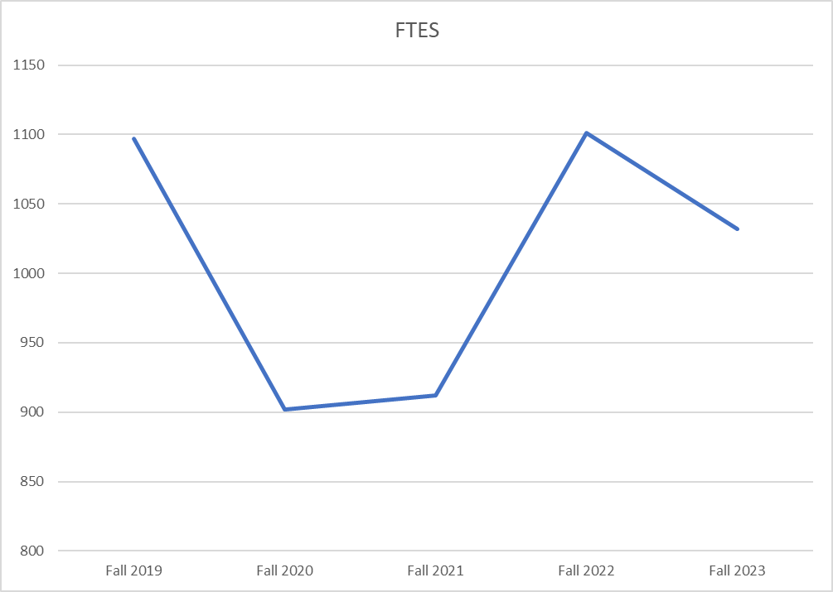
Managing student enrollment
Term | FTES
Fall 2019 | 1097
Fall 2020 | 902
Fall 2021 | 912
Fall 2022 | 1101
Fall 2023 | 1032 *
* End of term projection for fall 2023 based on 3 years of historical data. This projected FTES for fall 2023 is a decline of 6.3% from last fall and 5.9% lower than pre-pandemic level.

Slide 19
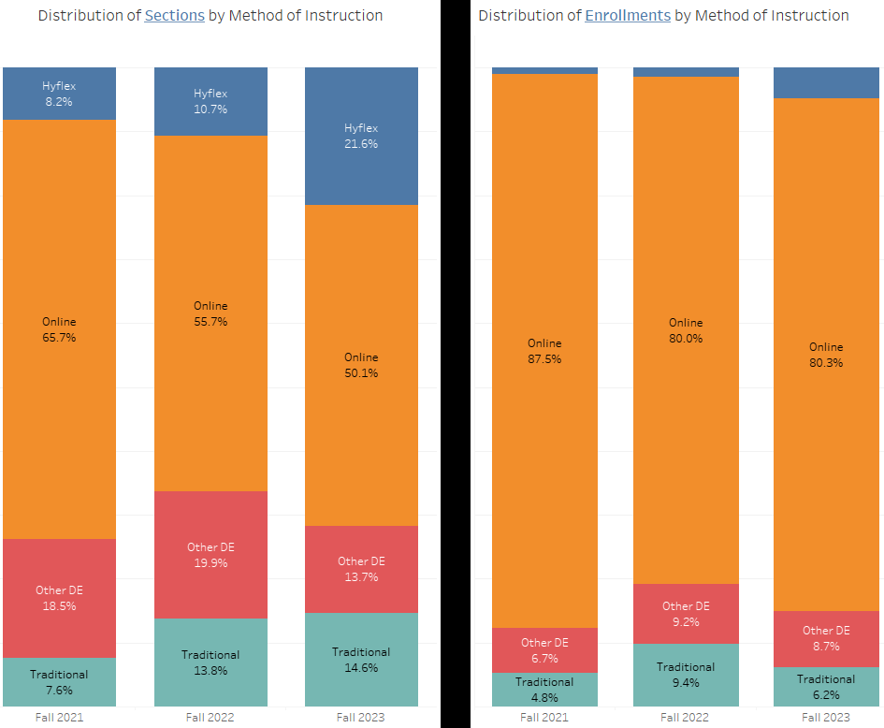
Shift in student selection of method of instruction
Online sections have decreased by 16 percentage points to 50%, however, the distribution of enrollments in online classes remains at 80%.
The distribution of Hyflex section offerings has increased 13 percentage points, while enrollments in those sections has increased only 4 percentage points, from 0.9% in fall 2021 to 4.8% in fall 2023.

Slide 20
Managing unfunded growth . . . While preparing for unprecedented need
Notes:
Based on the fact that we have essentially recovered the FTES lost during the pandemic, and because of our increasing Dual Enrollment offerings, noncredit courses and certificates, and the increased exposure our online classes will have through the California Community College Virtual Campus, we are confident that our enrollments will continue to grow.
The challenge that we foresee is due to the fact that funded growth in our system is controlled by statute – “growth authority” is based on each community’s need for access to college, as determined by local demographics. Factors include: educational attainment, unemployment and poverty.
For our District the growth authority is calculated to only .12%, extremely small (amounts to less than around $20K).
If statewide growth funding remains unused, Ed Code permits districts to grow beyond their calculated growth authority, but not to exceed 10% of our FTES base from the preceding fiscal year.

Slide 21
Notes:
We all know that Barstow is preparing for unprecedented population growth and economic development with the BNSF BIG project.
BCC is working hard to meet the workforce training needs of BNSF as well as the other existing and new businesses and organizations that will be needed to prepare for this growth.
How do we do this when the State manages the amount of growth funding we can receive.
In order to meet the need, we will be ramping our grant-seeking efforts and significantly expanding our contract education program, which provides direct and customized training to the employees of corporations, small businesses, and even government agencies.
Our capacity and willingness to partner well with all of these entities is critical.

Slide 22
Notes:
One of our partners, is the Chancellor’s Office. I will be reaching out to the new Chancellor, Dr. Sonya Christian, to make sure she understands the importance of our work to not only Barstow, but to the state and nation.

Slide 25
Thank you!

